Slide 1

Views
A View is like an SQL query that is stored in the database with an associated name.
It is kind of a virtual table which contains the result set of an SQL query.
A view can contain all rows of a table or selected rows from a table. A view can be created from one or many tables depending on the written SQL query.
The basic syntax for creating a view is:
Advantages of using a view - http://stackoverflow.com/questions/4378068/when-to-use-a-view-instead-of-a-table

Slide 2


Consider our STUDENTS and COURSES table. Suppose we are often interested in finding the names, identifiers and gpa’s of students who maintain their gpa of 3.5 and above.
We can define a view for this purpose as shown below:
QUERY RESULT
Once you execute the above query, a view will be created. In order to see the results, we need to query the view using:
SELECT * FROM GPA-FILTER;
A view always shows up-to-date data. The DBMS recreates the data, using the view's SQL statement, every time a user queries a view.

Slide 3

Updating Views:
There are certain restrictions while updating a view -
- The FROM clause should not contain multiple tables.
- The SELECT clause should not contain set operators.
- The SELECT clause should not contain aggregate functions, DISTINCT keyword or ORDER BY clause (We will look into these in further sections).
- The WHERE clause should not contain subqueries and the SQL query should not contain GROUP BY or HAVING clause (Will be discussed in later sections).
If a view satisfies all the above-mentioned rules, then we can update it.
The syntax to UPDATE a view is similar to updating a table.

Slide 4


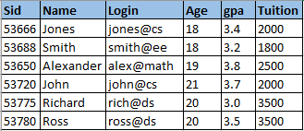
Let us update the gpa of John to 3.7 in our GPA-FILTER view:
QUERY RESULT
This UPDATE query would ultimately update the base table STUDENTS and same would reflect in the view. So, if we query the STUDENTS table, we would get the below result -
QUERY RESULT

Slide 5

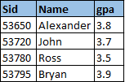
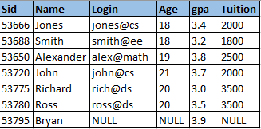
Inserting records into the View:
Rows of data can be inserted into a view in a similar way how we insert records into a table.
The same rules that apply to UPDATE command also applies for INSERT.
The INSERT operation would ultimately update the STUDENTS table. An example to insert a new row through the view:
QUERY
RESULT

Slide 6
We inserted data into Sid, Name and gpa columns and hence the rest of the columns are updated to NULL in the STUDENTS table.
Remember that primary key columns are not allowed to contain NULL values. Therefore, if we attempt to insert rows through a view that does not contain the primary key of the underlying table, the insertions will be rejected.
For example, if the view GPA-FILTER contained Name and gpa but not Sid, we could not insert rows through INSERT operation.
Deleting records from the View:
Rows of data can be deleted from a view in a similar way how we delete records from a table.
The same rules that apply to UPDATE command also applies for DELETE.

Slide 7

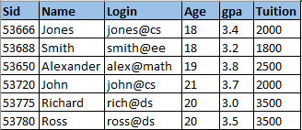

The DELETE operation would ultimately delete records from the STUDENTS table. An example to delete a record through the view:
QUERY
RESULT
Dropping a View:
When a view is no longer needed, we can delete/drop a View in a similar way how we drop tables.
DROP VIEW GPA-FILTER;

Slide 8

DISTINCT:
The SQL DISTINCT keyword, used in conjunction with the SELECT statement, eliminates all duplicate records from the resultant table and returns only unique records.
DISTINCT is one of the frequently used keywords while querying tables as there will be many situations where you have duplicate records in a table and it makes sense to fetch only unique records.
The basic syntax of DISTINCT is:
Let us consider our STUDENTS table and try to fetch the unique age of all the students.

Slide 9




QUERY RESULT
If we did not use a DISTINCT keyword in the above query, the resultant table would contain the value of 18 and 20 twice.
As another example, let us fetch the name and age details of all the students who took course C101 or C401.
QUERY RESULT
Note that ‘Jones’ would appear twice in the resultant table if DISTINCT keyword was not used.

Slide 10


ALIAS:
SQL aliases are used to give a temporary name to a database table, or a column in a table.
The renaming is a temporary change and the actual table name or a column name does not change in the database.
Basically aliases are used to make table names and column names more readable.
The basic syntax to create an alias is:
Table alias Column alias

Slide 11



Aliases can be applied on almost every SQL query that we write. Let us retrieve the name, course and grade details of all students who scored an ‘A’ and use table alias to make the query more readable:
QUERY RESULT
We can also use column alias on the above query:
QUERY
RESULT

Slide 12
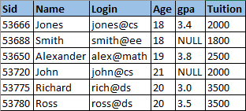
IS NULL and IS NOT NULL:
Recall the NOT NULL constraint discussed during Day 4 of the course. NOT NULL constraint ensures that all rows in a table contain a definite value for the column, which is specified as NOT NULL.
The other columns, which are not specified with a NOT NULL constraint are allowed to contain NULL values within them.
NULL values usually represent missing or unknown data.
Let us consider the STUDENT table to contain few NULL values -

Slide 13



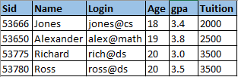
Now, how can we test for NULL values in a table? We cannot use comparison operators such as =,<,> etc. to test for NULL values.
This is where IS NULL and IS NOT NULL operators come into picture.
Let us fetch all the student records who don’t have any gpa recorded. This can be achieved using the IS NULL operator as shown below:
QUERY RESULT
Similarly we can use IS NOT NULL to determine the not null values.
QUERY RESULT

